Slide 1
Lab Task #3

Slide 2
Why I fear during a presentation?
Depression
Anxiety
Be forgot about something
Lack of confidence
Bad dressing

Slide 3
Mobile
A mobile phone is a wireless handheld device that allows users to make and receive calls. While the earliest generation of mobile phones could only make and receive calls, today’s mobile phones do a lot more, accommodating web browsers, games, cameras, video players and navigational systems.

Slide 4

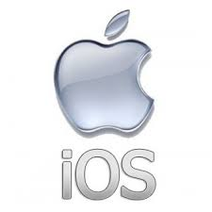
Comparison of Android and IOS
Android
IOS
Developed by google
Open Source
Mostly written in java
Developed by Apple
Closed ecosystem
Mostly written in Swift

Slide 5
Advantages and disadvantages of mobiles
Advantages
Call & text
Latest news updates
Take photos and videos
Research anything anytime
Shop Online
Portable music player
Disadvantages
Distraction
Ear Problem
Wastage of time
Loss of study
Health problems
Privacy issues
Distance from family

Slide 6
Thank you
Submitted to: M Ahsan

